Slide 1
Matrix Algebra
MATRIX FACTORIZATIONS

Slide 2
MATRIX FACTORIZATIONS
A factorization of a matrix A is an equation that expresses A as a product of two or more matrices.
Whereas matrix multiplication involves a synthesis of data (combining the effects of two or more linear transformations into a single matrix), matrix factorization is an analysis of data.

Slide 3
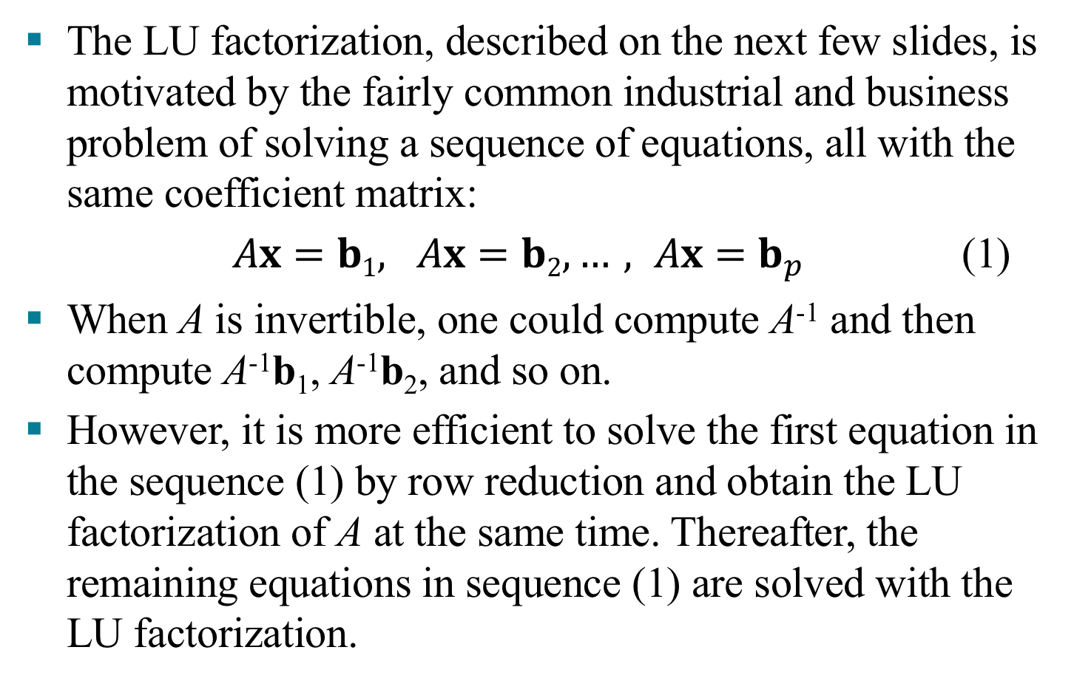
THE LU FACTORIZATION
The LU factorization, described on the next few slides, is motivated by the fairly common industrial and business problem of solving a sequence of equations, all with the same coefficient matrix:
$Ax=b1, Ax=b2, …, Ax=b_{p}$ (1)
When A is invertible, one could compute A⁻¹ and then compute A⁻¹b₁, A⁻¹b₂, and so on.
However, it is more efficient to solve the first equation in the sequence (1) by row reduction and obtain the LU factorization of A at the same time. Thereafter, the remaining equations in sequence (1) are solved with the LU factorization.

Slide 4
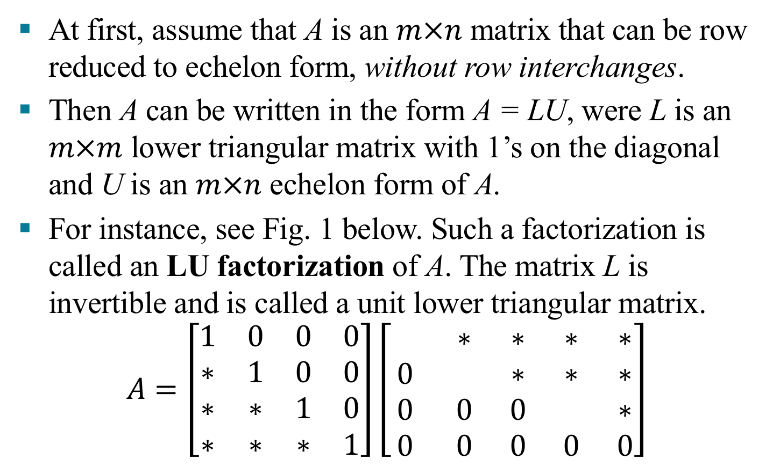
THE LU FACTORIZATION
At first, assume that A is an $m×n$ matrix that can be row reduced to echelon form, without row interchanges.
Then A can be written in the form A = LU, were L is an $m×m$ lower triangular matrix with 1’s on the diagonal and U is an $m×n$ echelon form of A.
For instance, see Fig. 1 below. Such a factorization is called an LU factorization of A. The matrix L is invertible and is called a unit lower triangular matrix.
$$A=\left[\begin{matrix}1 & 0 & 0 & 0 \\ ∗ & 1 & 0 & 0 \\ ∗ & ∗ & 1 & 0 \\ ∗ & ∗ & ∗ & 1\end{matrix}\right]\left[\begin{matrix} & ∗ & ∗ & ∗ & ∗ \\ 0 & & ∗ & ∗ & ∗ \\ 0 & 0 & 0 & & ∗ \\ 0 & 0 & 0 & 0 & 0\end{matrix}\right]$$

Slide 5
THE LU FACTORIZATION
Before studying how to construct L and U, we should look at why they are so useful. When A = LU, the equation Ax = b can be written as L(Ux) = b.
Writing y for Ux, we can find x by solving the pair of equations
First solve Ly = b for y, and then solve Ux = y for x. See Fig. 2 on the next slide. Each equation is easy to solve because L and U are triangular.
Ly = b
Ux = y

Slide 6
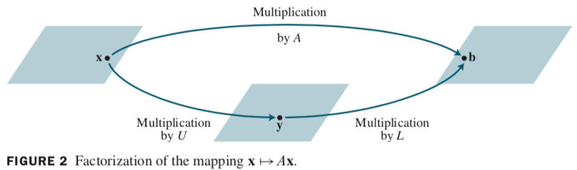
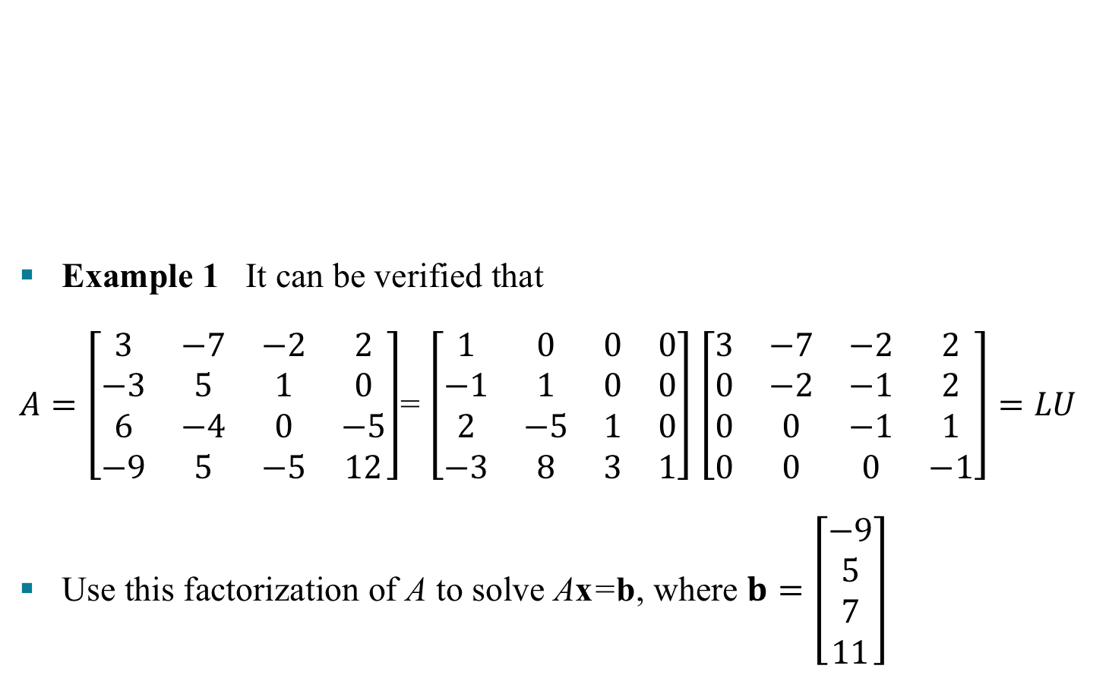
THE LU FACTORIZATION
Example 1 It can be verified that
$A=\left[\begin{matrix}3 & −7 & −2 & 2 \\ −3 & 5 & 1 & 0 \\ 6 & −4 & 0 & −5 \\ −9 & 5 & −5 & 12\end{matrix}\right]$= $\left[\begin{matrix}1 & 0 & 0 & 0 \\ −1 & 1 & 0 & 0 \\ 2 & −5 & 1 & 0 \\ −3 & 8 & 3 & 1\end{matrix}\right]$ $\left[\begin{matrix}3 & −7 & −2 & 2 \\ 0 & −2 & −1 & 2 \\ 0 & 0 & −1 & 1 \\ 0 & 0 & 0 & −1\end{matrix}\right]=LU$
Use this factorization of A to solve Ax=b, where $b=\left[\begin{aligned}−9 \\ 5 \\ 7 \\ 11\end{aligned}\right]$

Slide 7
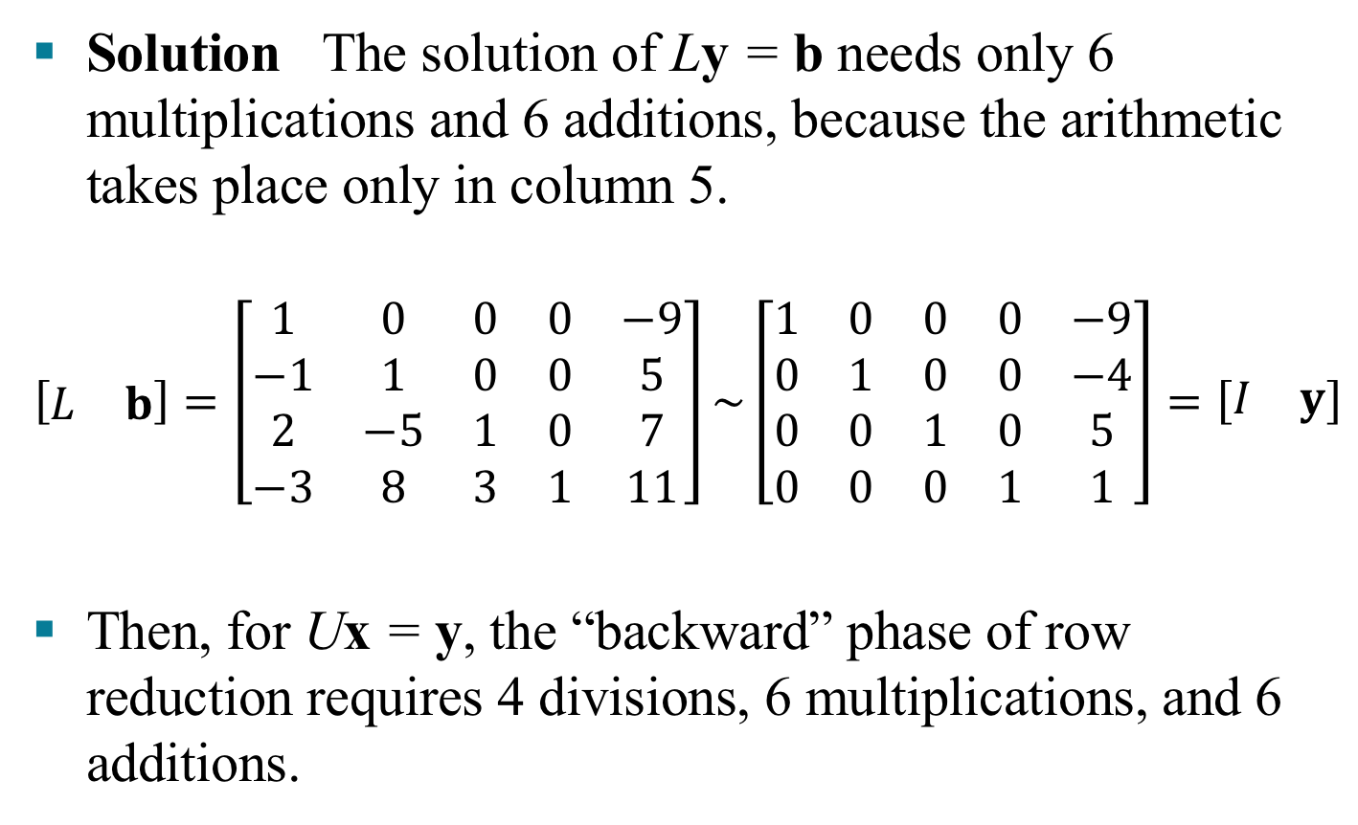
THE LU FACTORIZATION
Solution The solution of Ly = b needs only 6 multiplications and 6 additions, because the arithmetic takes place only in column 5.
$$\left[\begin{matrix}L & b\end{matrix}\right]=\left[\begin{matrix}1 & 0 & 0 & 0 & −9 \\ −1 & 1 & 0 & 0 & 5 \\ 2 & −5 & 1 & 0 & 7 \\ −3 & 8 & 3 & 1 & 11\end{matrix}\right]\sim \left[\begin{matrix}1 & 0 & 0 & 0 & −9 \\ 0 & 1 & 0 & 0 & −4 \\ 0 & 0 & 1 & 0 & 5 \\ 0 & 0 & 0 & 1 & 1\end{matrix}\right]=\left[\begin{matrix}I & y\end{matrix}\right]$$
Then, for Ux = y, the “backward” phase of row reduction requires 4 divisions, 6 multiplications, and 6 additions.

Slide 8
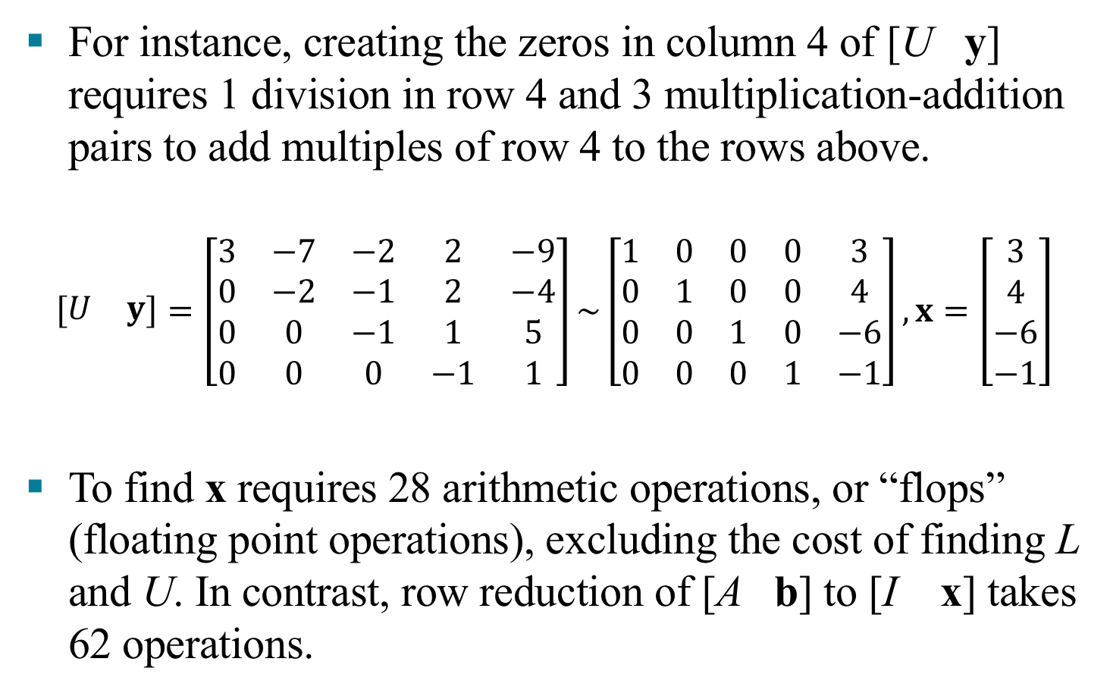
THE LU FACTORIZATION
For instance, creating the zeros in column 4 of [U y] requires 1 division in row 4 and 3 multiplication-addition pairs to add multiples of row 4 to the rows above.
$$\left[\begin{matrix}U & y\end{matrix}\right]=\left[\begin{matrix}3 & −7 & −2 & 2 & −9 \\ 0 & −2 & −1 & 2 & −4 \\ 0 & 0 & −1 & 1 & 5 \\ 0 & 0 & 0 & −1 & 1\end{matrix}\right]\sim \left[\begin{matrix}1 & 0 & 0 & 0 & 3 \\ 0 & 1 & 0 & 0 & 4 \\ 0 & 0 & 1 & 0 & −6 \\ 0 & 0 & 0 & 1 & −1\end{matrix}\right],x=\left[\begin{matrix}3 \\ 4 \\ −6 \\ −1\end{matrix}\right]$$
To find x requires 28 arithmetic operations, or “flops” (floating point operations), excluding the cost of finding L and U. In contrast, row reduction of [A b] to [I x] takes 62 operations.

Slide 9
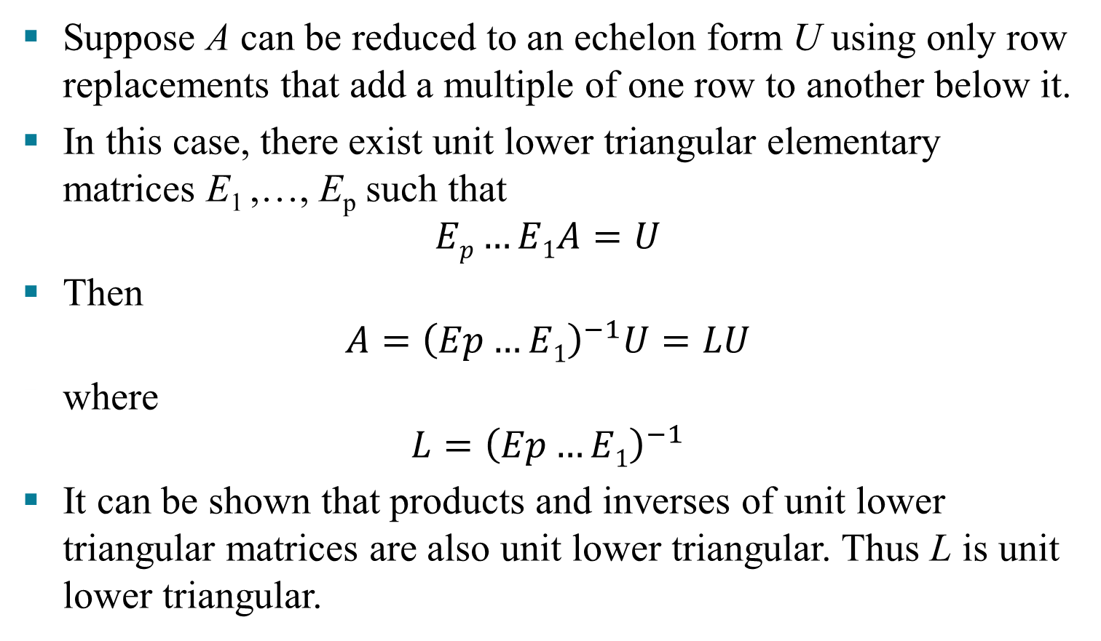
AN LU FACTORIZATION ALGORITHM
Suppose A can be reduced to an echelon form U using only row replacements that add a multiple of one row to another below it.
In this case, there exist unit lower triangular elementary matrices E₁ ,…, E_{p} such that
$$Ep…E1A=U$$
Then
$$A={\left(Ep…E1\right)}^{−1}U=LU$$
where
$$L={\left(Ep…E1\right)}^{−1}$$
It can be shown that products and inverses of unit lower triangular matrices are also unit lower triangular. Thus L is unit lower triangular.
(3)
(4)

Slide 10

AN LU FACTORIZATION ALGORITHM
Note that row operations in equation (3), which reduce A to U, also reduce the L in equation (4) to I, because $Ep…E1L=\left(Ep…E1\right){\left(Ep…E1\right)}^{−1}=I$. This observation is the key to constructing L.
Algorithm for an LU Factorization
Reduce A to an echelon form U by a sequence of row replacement operations, if possible.
Place entries in L such that the same sequence of row operations reduces L to I.

Slide 11
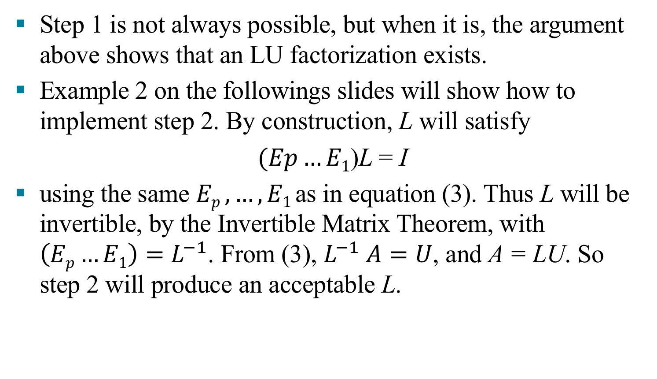
AN LU FACTORIZATION ALGORITHM
Step 1 is not always possible, but when it is, the argument above shows that an LU factorization exists.
Example 2 on the followings slides will show how to implement step 2. By construction, L will satisfy
$(Ep…E1$)L = I
using the same $Ep ,…,E1$as in equation (3). Thus L will be invertible, by the Invertible Matrix Theorem, with $\left(Ep…E1\right)=L^{−1}$. From (3), $L^{−1} A=U$, and A = LU. So step 2 will produce an acceptable L.

Slide 12
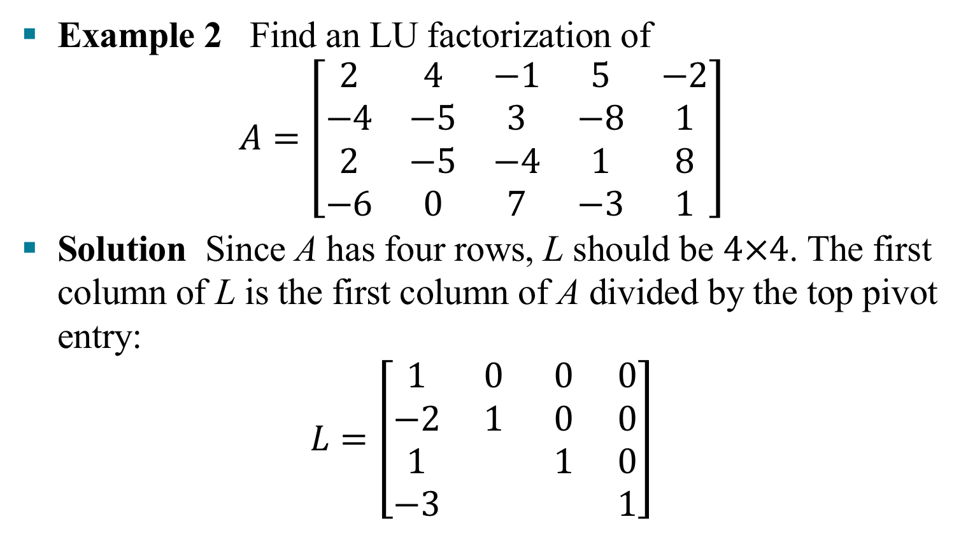
AN LU FACTORIZATION ALGORITHM
Example 2 Find an LU factorization of
$$A=\left[\begin{matrix}2 & 4 & −1 & 5 & −2 \\ −4 & −5 & 3 & −8 & 1 \\ 2 & −5 & −4 & 1 & 8 \\ −6 & 0 & 7 & −3 & 1\end{matrix}\right]$$
Solution Since A has four rows, L should be $4×4$. The first column of L is the first column of A divided by the top pivot entry:
$$L=\left[\begin{matrix}1 & 0 & 0 & 0 \\ −2 & 1 & 0 & 0 \\ 1 & & 1 & 0 \\ −3 & & & 1\end{matrix}\right]$$

Slide 13
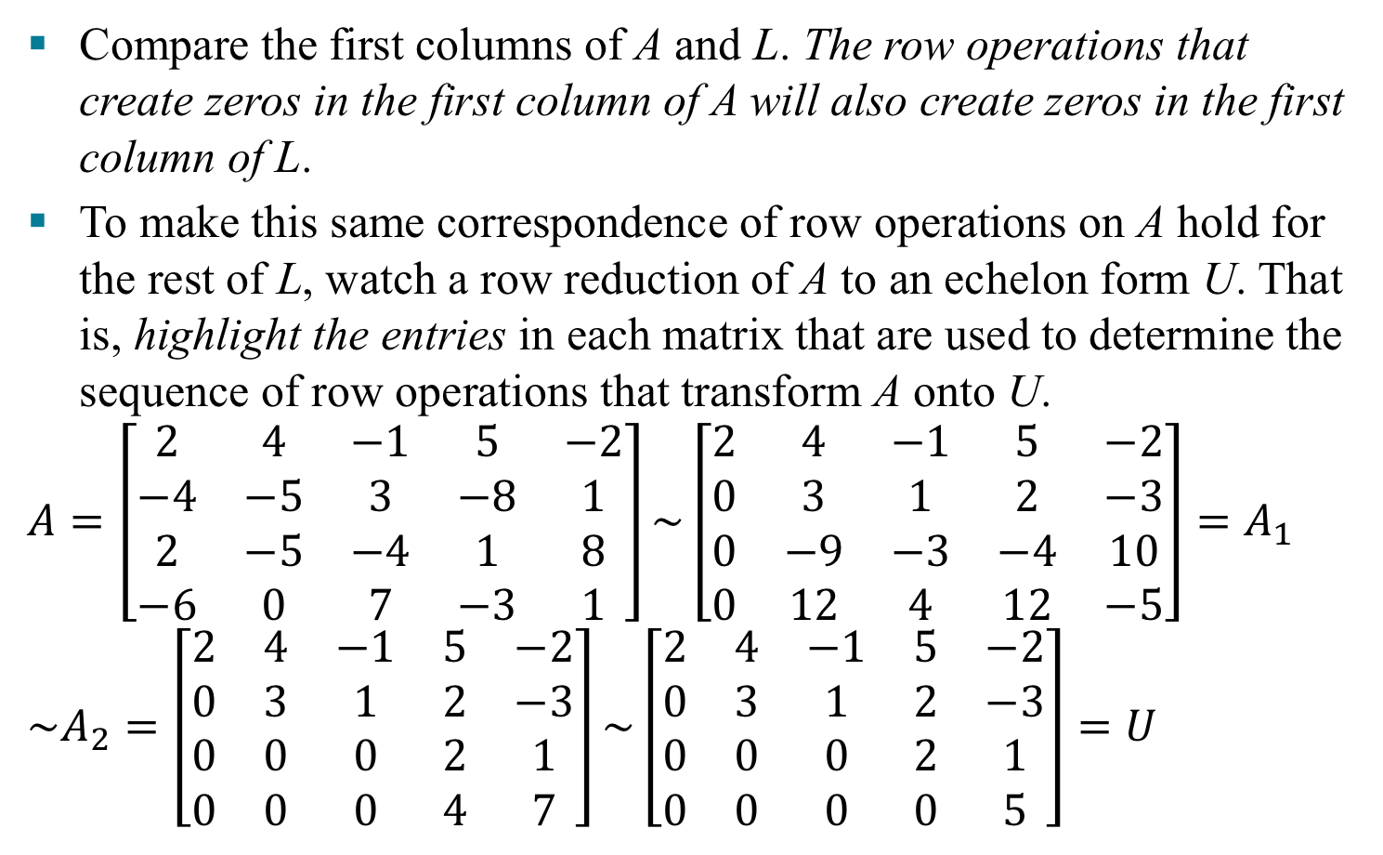
AN LU FACTORIZATION ALGORITHM
Compare the first columns of A and L. The row operations that create zeros in the first column of A will also create zeros in the first column of L.
To make this same correspondence of row operations on A hold for the rest of L, watch a row reduction of A to an echelon form U. That is, highlight the entries in each matrix that are used to determine the sequence of row operations that transform A onto U.
$$A=\left[\begin{matrix}2 & 4 & −1 & 5 & −2 \\ −4 & −5 & 3 & −8 & 1 \\ 2 & −5 & −4 & 1 & 8 \\ −6 & 0 & 7 & −3 & 1\end{matrix}\right]\sim \left[\begin{matrix}2 & 4 & −1 & 5 & −2 \\ 0 & 3 & 1 & 2 & −3 \\ 0 & −9 & −3 & −4 & 10 \\ 0 & 12 & 4 & 12 & −5\end{matrix}\right]=A_{1} \\ \sim A_{2}=\left[\begin{matrix}2 & 4 & −1 & 5 & −2 \\ 0 & 3 & 1 & 2 & −3 \\ 0 & 0 & 0 & 2 & 1 \\ 0 & 0 & 0 & 4 & 7\end{matrix}\right]\sim \left[\begin{matrix}2 & 4 & −1 & 5 & −2 \\ 0 & 3 & 1 & 2 & −3 \\ 0 & 0 & 0 & 2 & 1 \\ 0 & 0 & 0 & 0 & 5\end{matrix}\right]=U$$
(5)

Slide 14


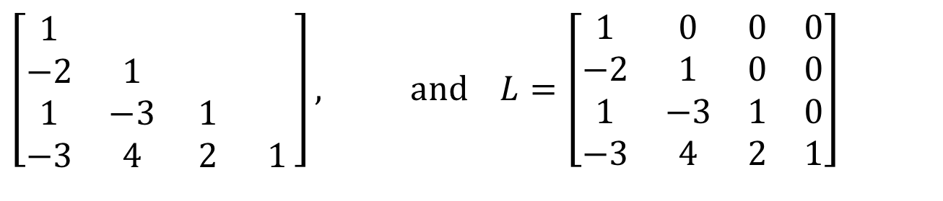


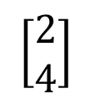

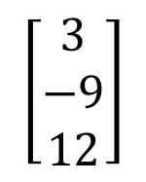

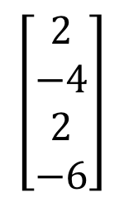
AN LU FACTORIZATION ALGORITHM
The highlighted entries above determine the row reduction of A to U. At each pivot column, divide the highlighted entries by the pivot and place the result onto L:
$$\left[\begin{matrix}2 \\ −4 \\ 2 \\ −6\end{matrix}\right]$$
$$\left[\begin{matrix}3 \\ −9 \\ 12\end{matrix}\right]$$
$$\left[\begin{matrix}2 \\ 4\end{matrix}\right]$$
$$\left[5\right]$$
$$÷2$$
$$÷3$$
$$÷2$$
$$÷5$$
$$\left[\begin{matrix}1 & & & \\ −2 & 1 & & \\ 1 & −3 & 1 & \\ −3 & 4 & 2 & 1\end{matrix}\right], \text{and} L=\left[\begin{matrix}1 & 0 & 0 & 0 \\ −2 & 1 & 0 & 0 \\ 1 & −3 & 1 & 0 \\ −3 & 4 & 2 & 1\end{matrix}\right]$$
An easy calculation verifies that this L and U satisfy LU = A.

